Slide 1

AI/ML : JOB TITLE NORMALIZATION v1.0
Team - 4
Vinay Danepalli – Project Leader
Chaitanya Kumar Battula - Developer
Gaurav Setty – Analyst/Developer
Aman Bajpayee – Developer

Slide 2
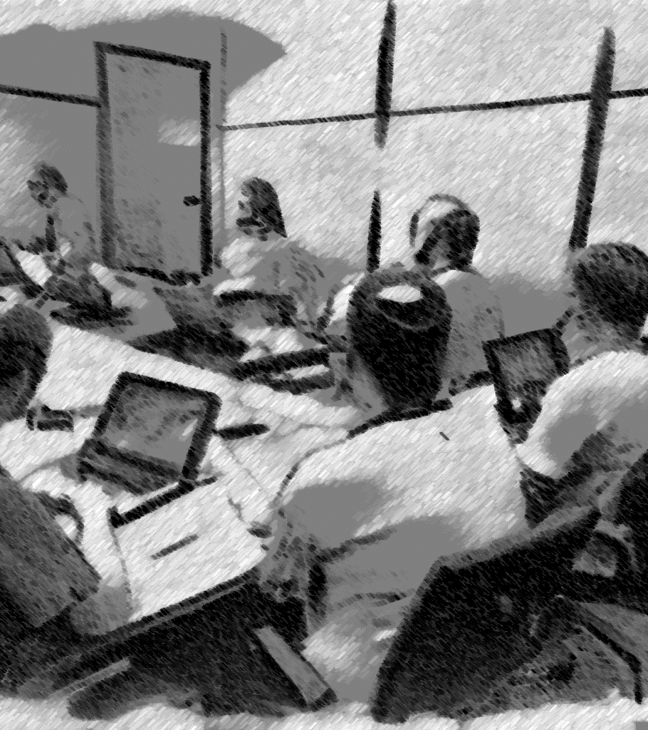
CONTents
Introduction
Purpose and Goal of Design Document
Design Constraints
Design Glossary
Use case model
Use case diagram
Sprint I
Use cases
Class diagram
Sprint II
Use cases
Class diagram
Conclusion and Sign-off
Implementation
Implementation
Demo
Model training and results
Model performance
Test data
Model output for test data
Learning Outcome
Notes:
Introduction (Project, Overview, What it relates to, Target audience, )

Slide 3
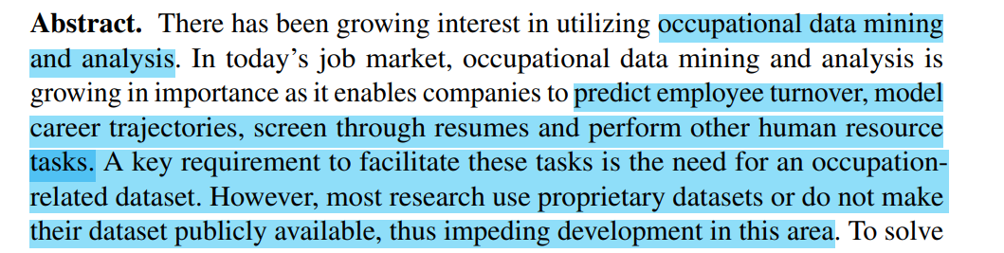
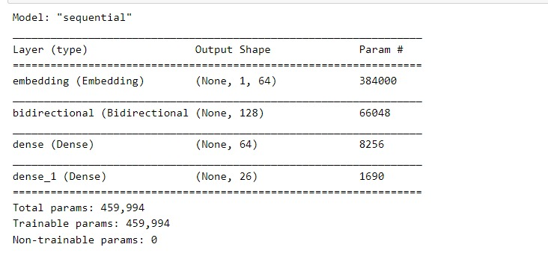
Introduction
Purpose and Goal of Design Document
Specify Objective, Scope of Project, Requirements, Design and Architecture, Implementation details, and Testing.
Design constraints
Data quality
Regulatory compliance
Computational Resources
Time
Design Glossary
Data Cleaning : Clean the text data by applying different techniques data to get more accurate predictions.
Data Pre-processing : Transforming raw data into usable format
Feature Extraction : Identify and extract relevant features
BiLSTM Bidirectional Long Short-Term Memory: Can process input sequences in both forward and backward directions. Remember context (RNN).
Notes:
World is changing everyday
New challenge
New requirement
New technology

Slide 4
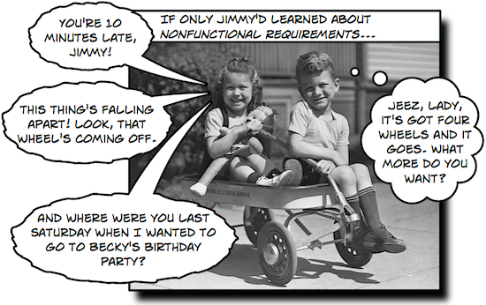
Software Requirement Specification
Functional requirements
Recognize resume data like skillsets, and descriptions.
Predict an apt Job title for the read input.
Normalize the predicted Job title.
Repeat above for every record of skillsets, and descriptions in the input file.
Non-functional requirements
Operate in real-time or near real-time : Speed
High accuracy rate in predicting and normalizing Job titles : Reliability
Handle large number of predictions : Scalability.
Notes:
Introduction (Project, Overview, What it relates to, Target audience, )

Slide 5
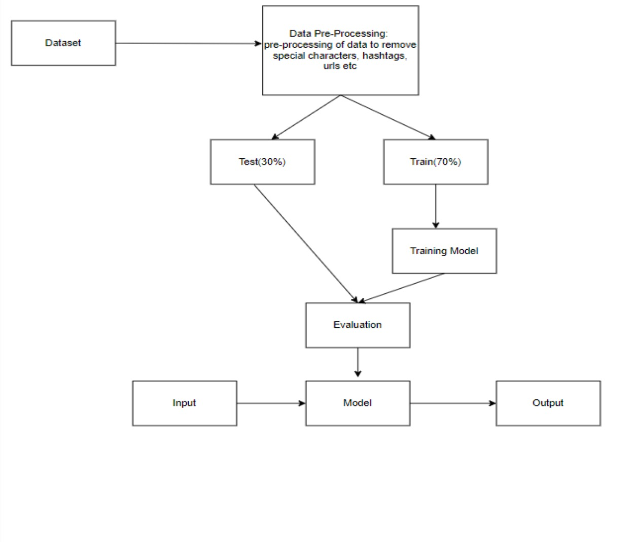
Software Design

Slide 6
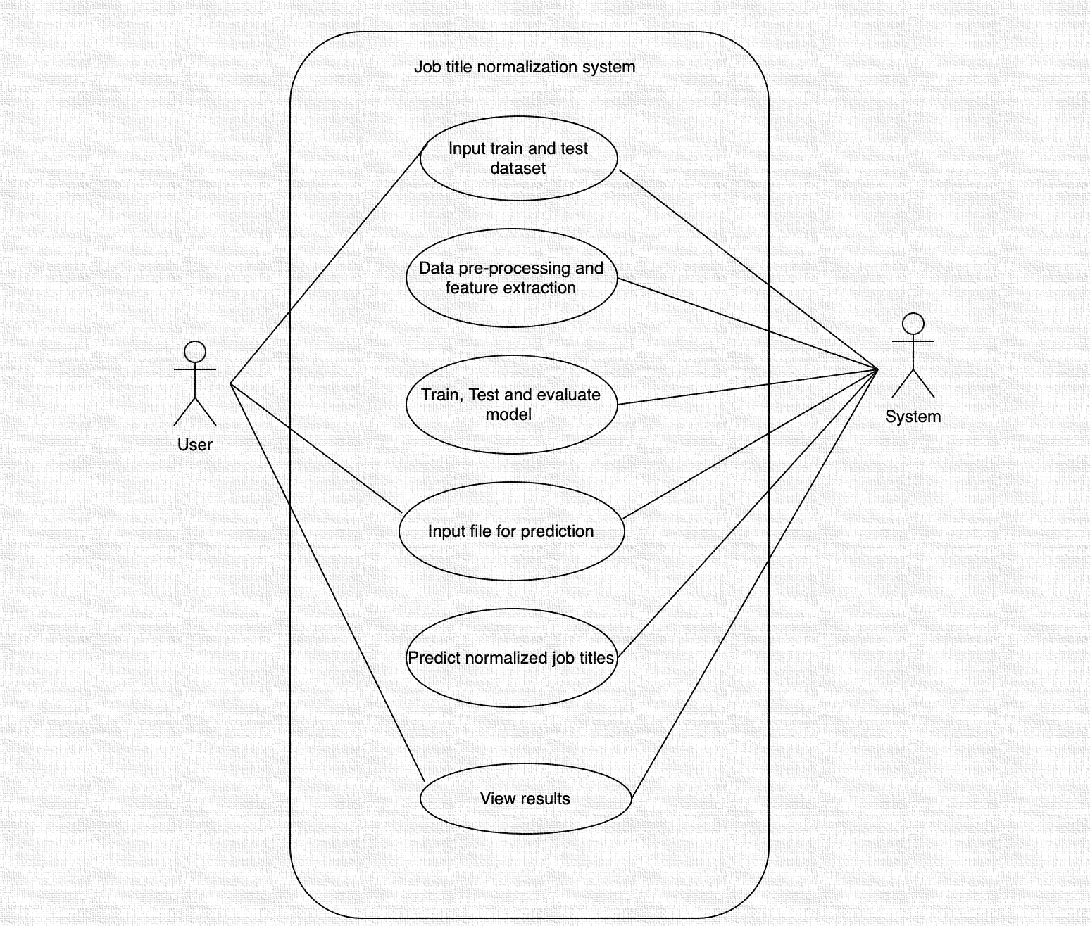
Use case model
Actors
User
System
Notes:
Introduction (Project, Overview, What it relates to, Target audience, )

Slide 7
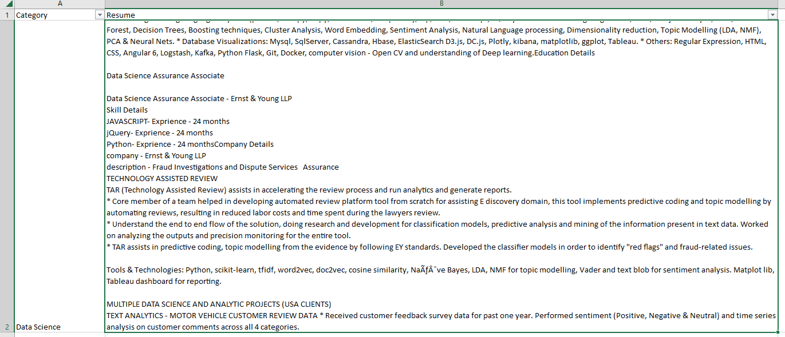
Sprint I : Use cases
Story I
Read input data
Perform initial analysis or data exploration
Story II
Data cleaning
URLs
Hashtags
Mentions (if any)
Punctuation
Feature extraction and data pre-processing
Get word embeddings. [vector or numerical representation of a word]
Notes:
General Data Protection Regulation – GDPR (EU)
California Consumer Privacy Act – CCPA (US)
Industrial and Professional Occupation Dataset - IPOD

Slide 8
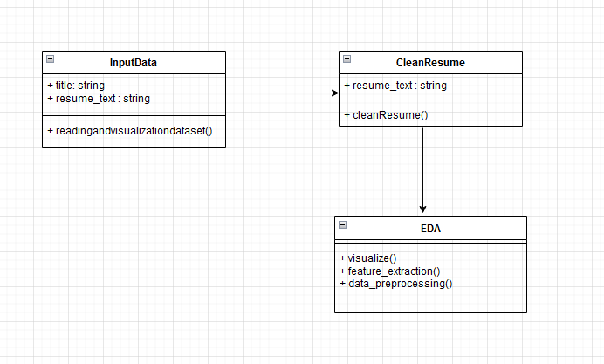
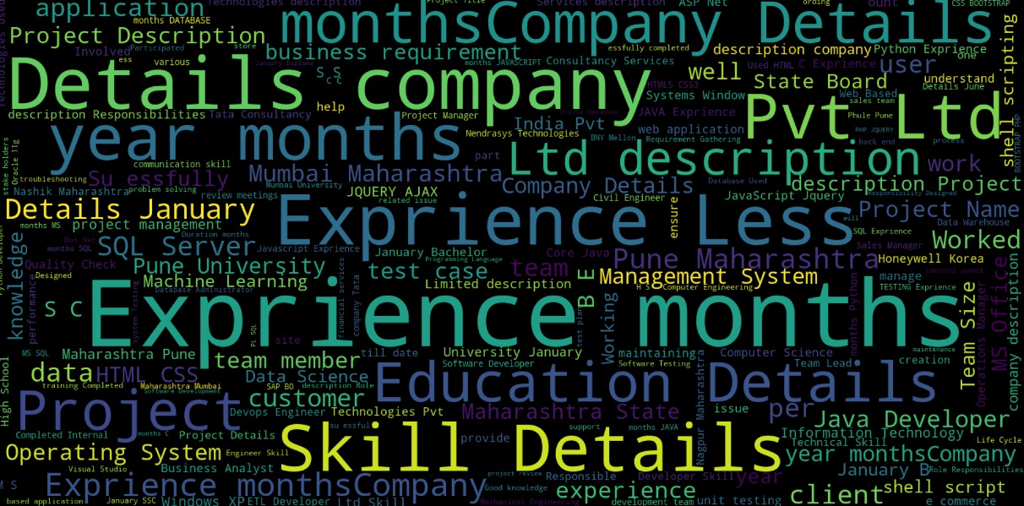
Sprint I : Class Diagram
Notes:
General Data Protection Regulation – GDPR (EU)
California Consumer Privacy Act – CCPA (US)
Industrial and Professional Occupation Dataset - IPOD

Slide 9
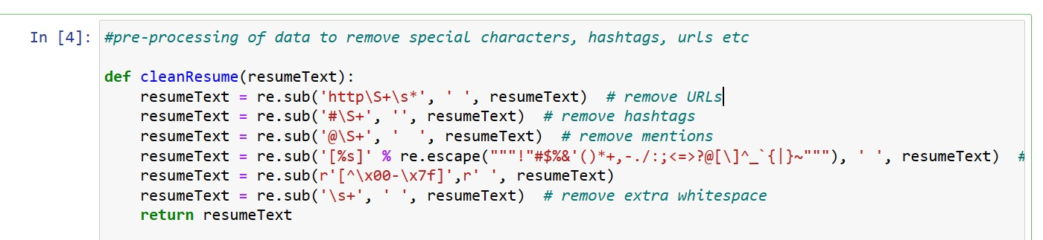
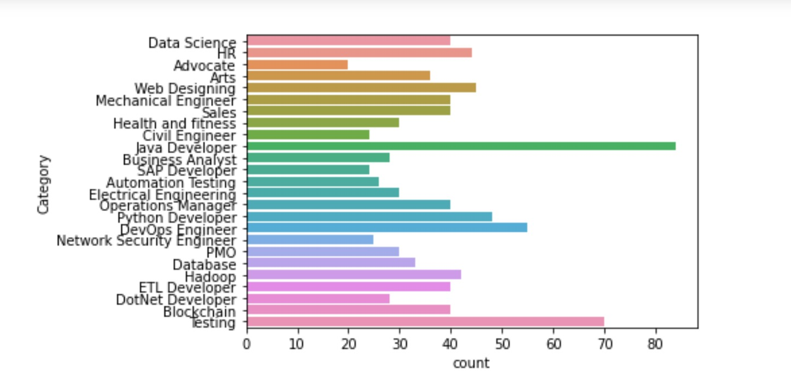
Sprint I : Implementation & Unit Testing
Modules | Input vs Output | Unit Testing Results
Read data | Input: CSV, Output: Data Frame | pass
Clean data | Input, Output : Data Frame | pass
Feature extraction | Input, Output : Data Frame | Pass
Notes:
General Data Protection Regulation – GDPR (EU)
California Consumer Privacy Act – CCPA (US)
Industrial and Professional Occupation Dataset - IPOD

Slide 10
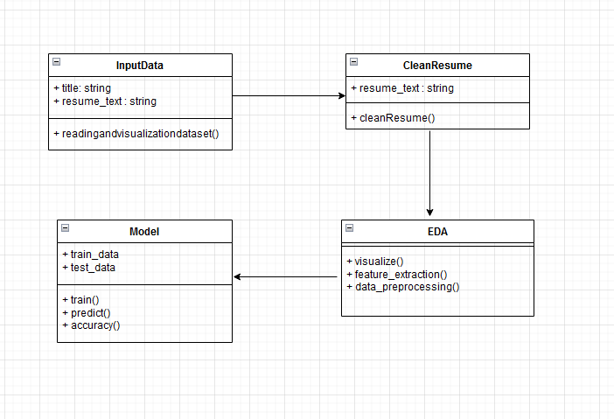
Sprint II : Use cases and Class Diagram
Story III
Train test split
Define model
Train and test the built modelc
Notes:
General Data Protection Regulation – GDPR (EU)
California Consumer Privacy Act – CCPA (US)
Industrial and Professional Occupation Dataset - IPOD

Slide 11
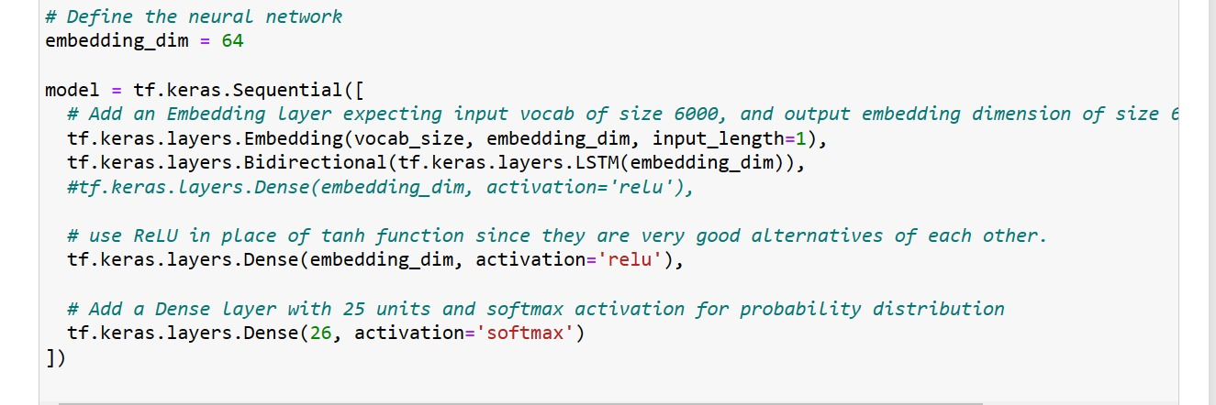
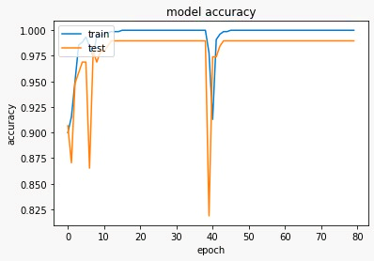
Sprint II : Implementation & Unit Testing
Modules | Input vs Output | Unit Testing Results
Model building | Input: Data Frame, Output: Model | pass
Predict output | Input: Data, Output: predicted job title | pass
Notes:
General Data Protection Regulation – GDPR (EU)
California Consumer Privacy Act – CCPA (US)
Industrial and Professional Occupation Dataset - IPOD

Slide 12
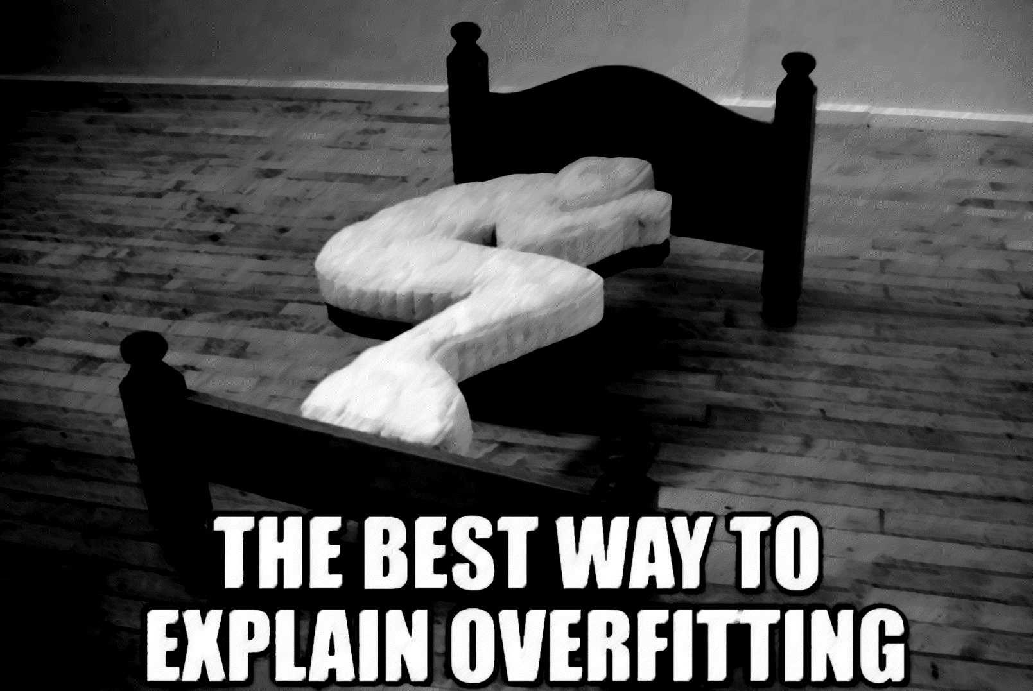
Software Requirement Specification
Risks
Overfitting/Underfitting - Can be avoided using techniques such as early stopping during the model training
Lower accuracy – Solution is to get more quality data
Project Tools/Frameworks
Programming Language : Python
Machine Learning Libraries : Scikit-learn, PyTorch, nltk
Data Visualization Tools : Matplotlib, Seaborn, Plotly
IDEs : PyCharm, Visual Studio Code, Jupyter Notebook
Laptop / Thin client.
Notes:
Introduction (Project, Overview, What it relates to, Target audience, )

Slide 13
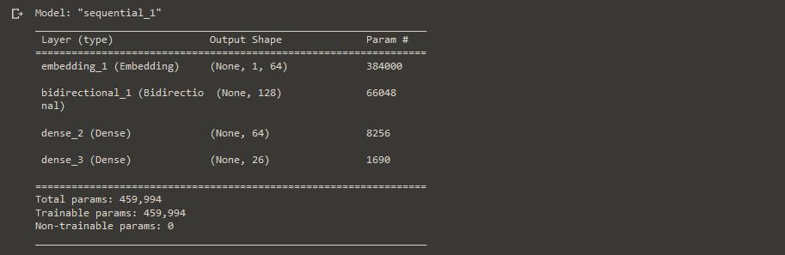
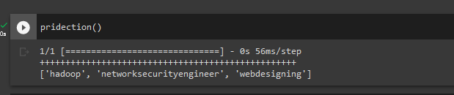
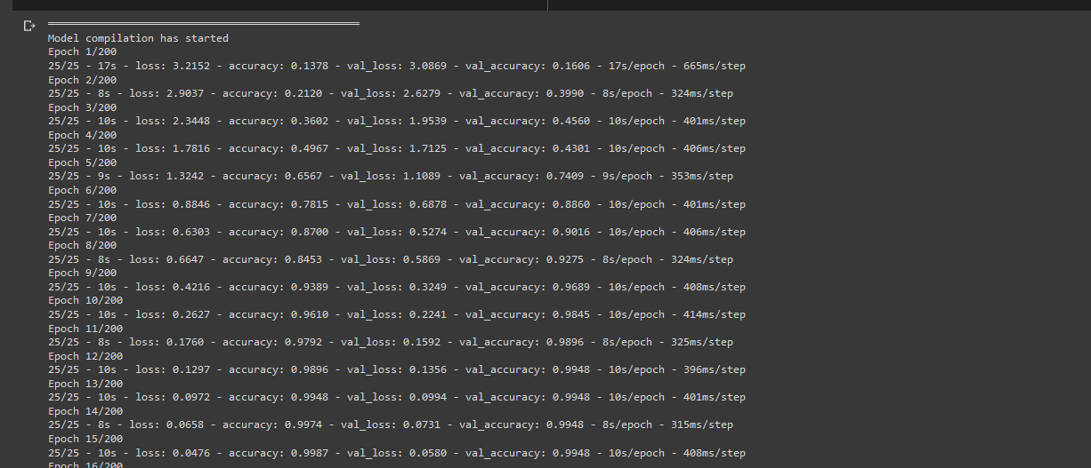
Model Training and Results

Slide 14
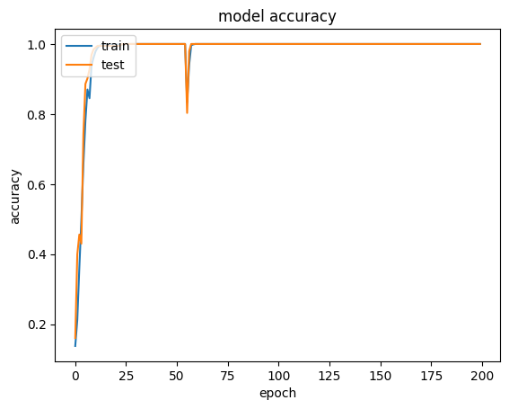
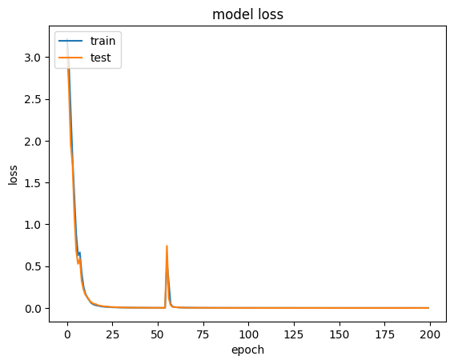
Model Performance
10 Epochs : 80% accuracy
20 Epochs : 85-90 % accuracy
> 20 Epochs : 99%

Slide 15
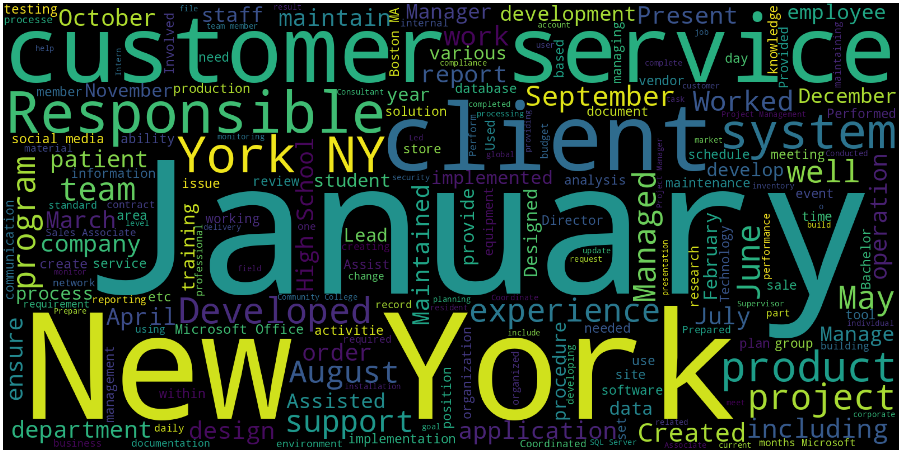
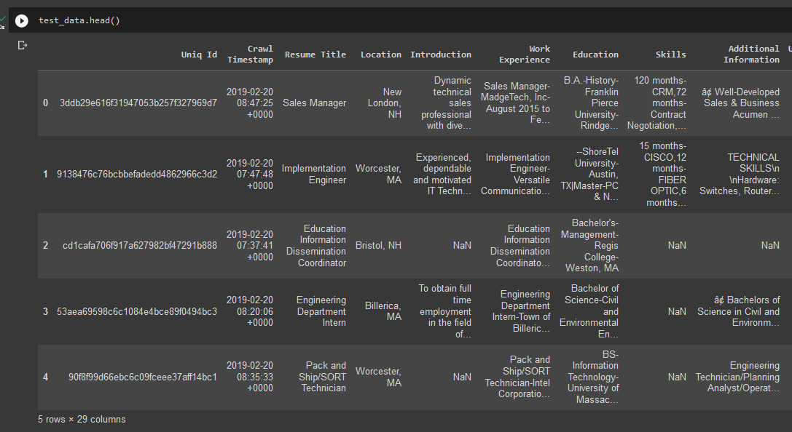
Test data

Slide 16
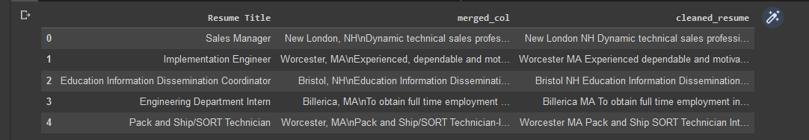
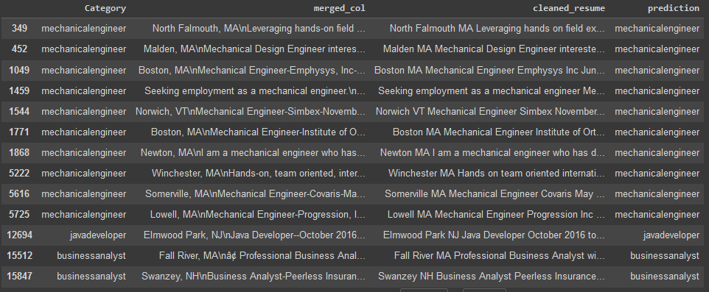
Model output for test data

Slide 17
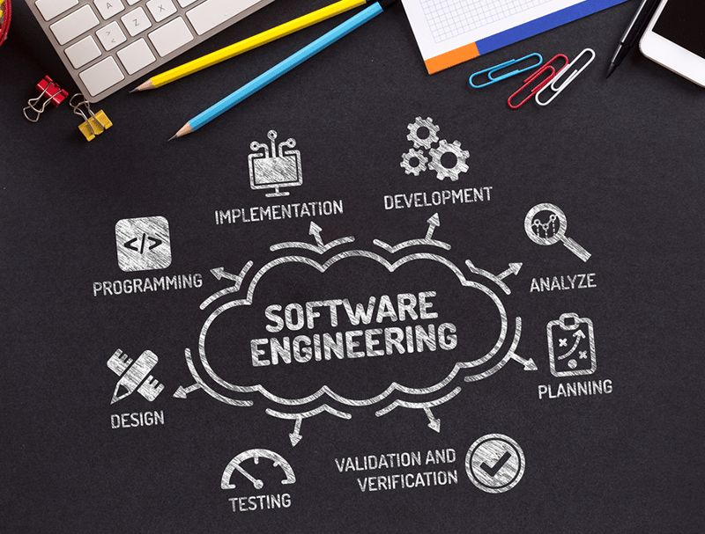
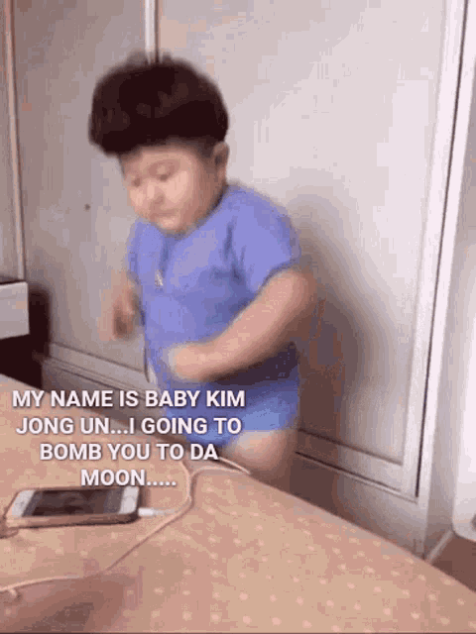
Learning Outcome

Slide 18
References
A Large-scale Industrial and Professional Occupation Dataset https://arxiv.org/pdf/2005.02780v1.pdf
Predicting Job Titles from Job Descriptions with Multi-label Text Classification https://arxiv.org/pdf/2112.11052v2.pdf
Text Normalization for Natural Language Processing (NLP) https://towardsdatascience.com/text-normalization-for-natural-language-processing-nlp-70a314bfa646
Notes:
Introduction (Project, Overview, What it relates to, Target audience, )

Slide 19
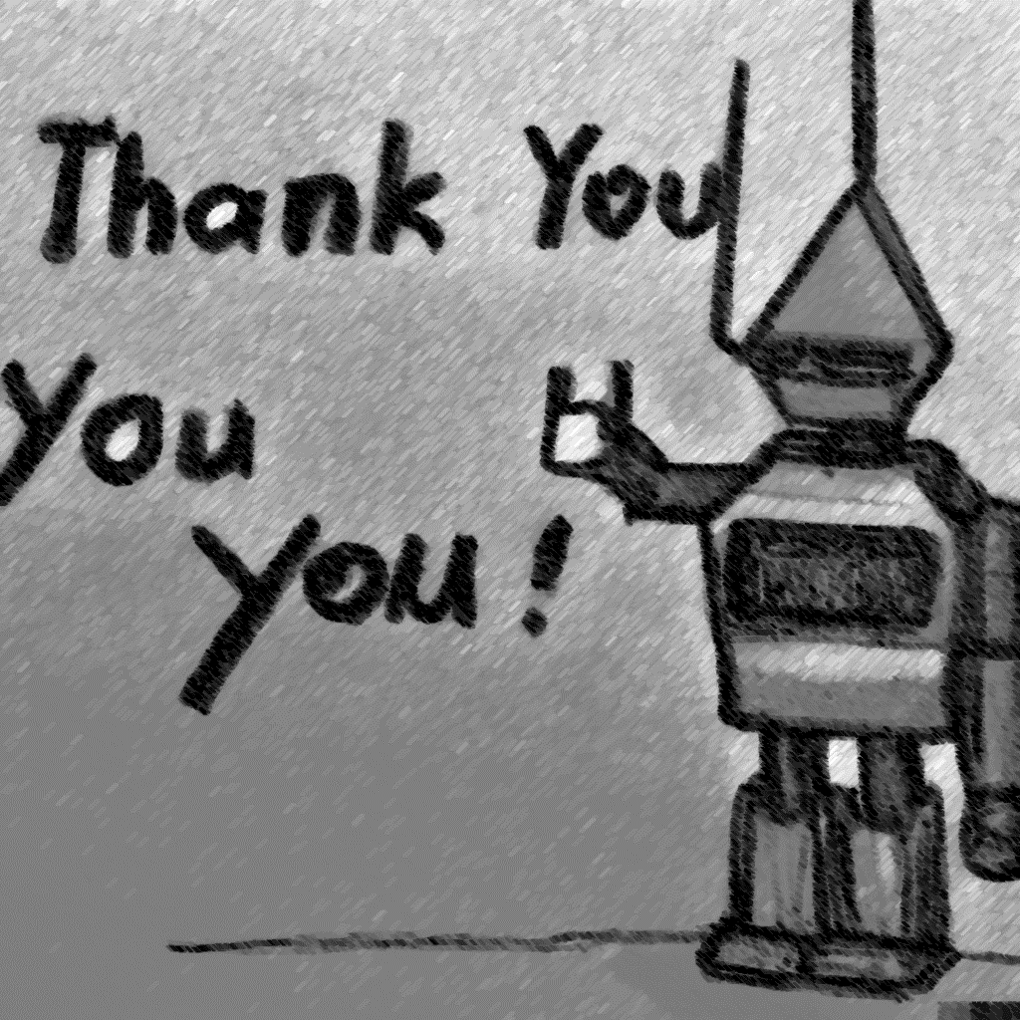
Notes:
Introduction (Project, Overview, What it relates to, Target audience, )

